Slide 1

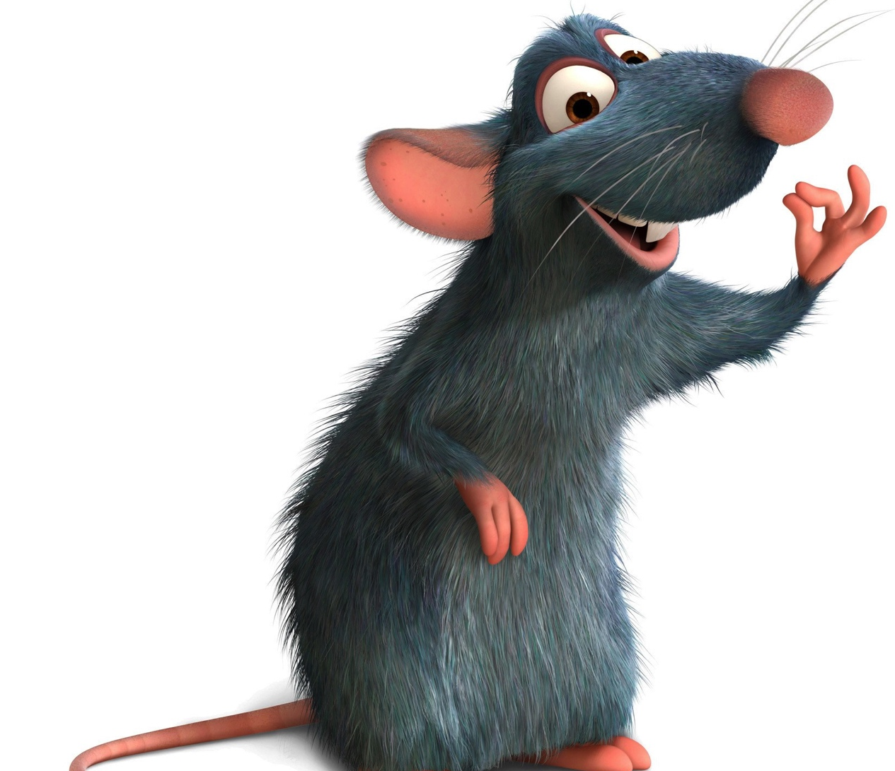
Splat the Rat
Jake Willis Fleming

Slide 2
Structure
Welcome
A few obligatory Puns
Motivations
Preparation
Technical Demonstration
Wins & Tribulations

Slide 3

A few obligatory puns
Rat here, rat now
Ruckus in the Metropolis

Slide 4
ATTENTION
Whoever is paying attention please interrupt me and say…
“Hang on, Jake, why the rats? Why not whack-a-mole?”
Whichever kind soul did this, I will get you a beer.

Slide 5
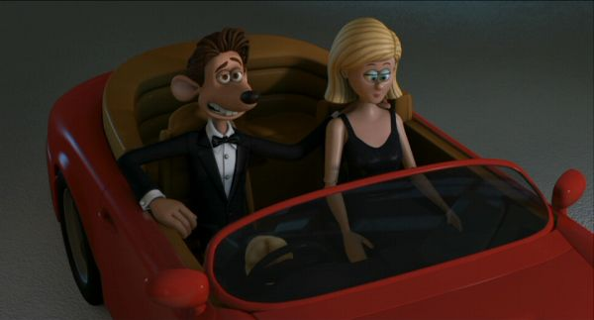
Reasons for Killing Rats

Slide 6
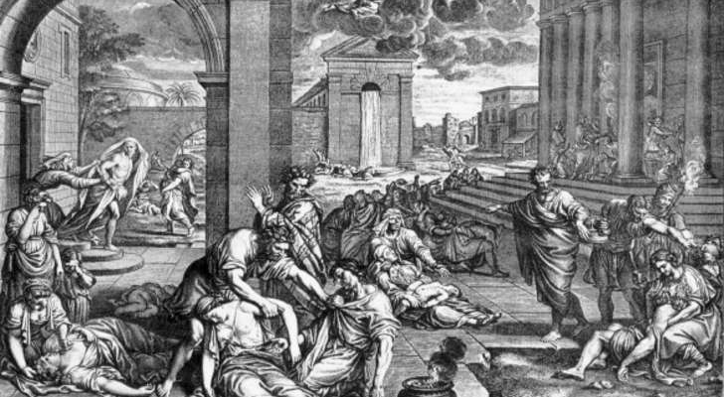
Reasons for Killing Rats

Slide 7
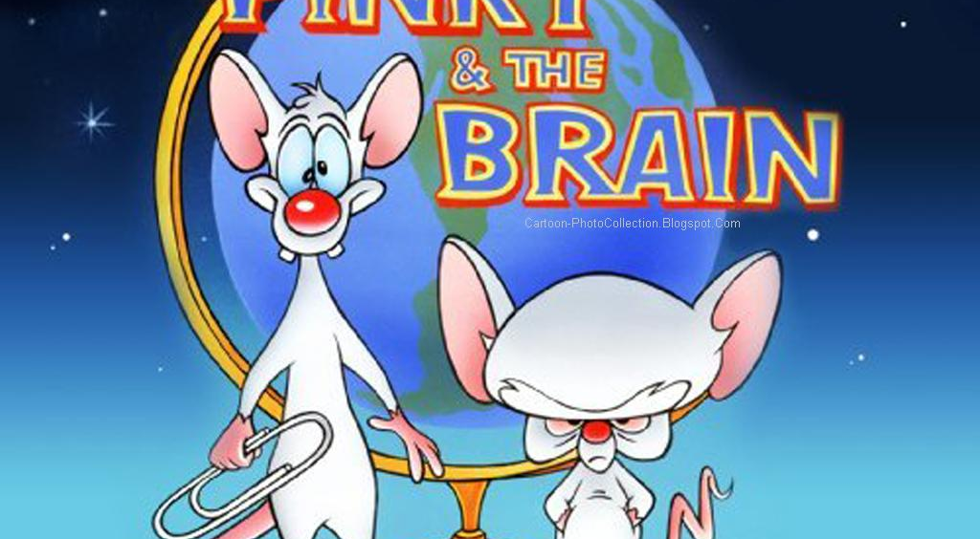
Reasons for Killing Rats

Slide 8
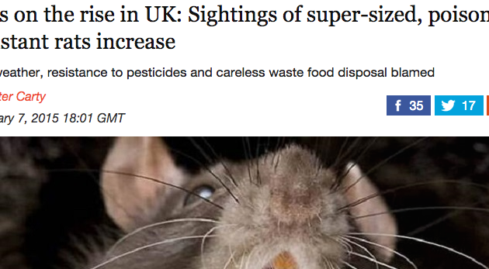
Reasons for Killing Rats

Slide 9
Preparation Station
A lot of Pseudo Code
Trello board
Mini-wins

Slide 10
Tech Dem
Let the Splatting Commence…

Slide 11
Wins & Tribulations
Tribulations
Coding is hard – remember that
Wins
Sound Manager
CSS
Gifs

Slide 12
?Questions?

